Slide 1
Predictive Maintenance System for Water Pipelines
Team Innovexa
Sukirtha Shree R
Thiruvenpha T
Jeevadharshini L
Kiruba Shamili

Slide 2
Predictive Maintenance System for Water Pipelines
Team Innovexa
Sukirtha Shree R
Thiruvenpha T
Jeevadharshini L
Kiruba Shamili

Slide 3




Predictive Maintenance System for Water Pipelines
Innovexa
Problem Statement
Existing systems detect leaks, but we need a predictive solution to monitor pipeline health and prevent failures, leaks, contamination, and structural damage before they occur.
Solution
A multi-sensor predictive maintenance system using IoT sensors (Pressure, Flow, Vibration, Temperature, Water Quality), MySQL for data storage, ML algorithms for failure prediction, and real-time alerts via Twilio SMS and mobile app notifications.
Emergency!
Leak detected

Slide 4
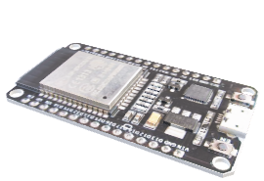
System Architecture
Predictive Maintenance System for Water Pipelines
Innovexa
Emergency!
Leak detected
ESP32 Microcontroller
Collects sensor data
MySQL Database
Stores real-time data.
Machine Learning Model (LSTM & Autoencoder)
Predicts failures.
Mobile App
Alerts users.
Monitors pipeline health

Slide 5
Hardware Components
Predictive Maintenance System for Water Pipelines
Innovexa

Slide 6
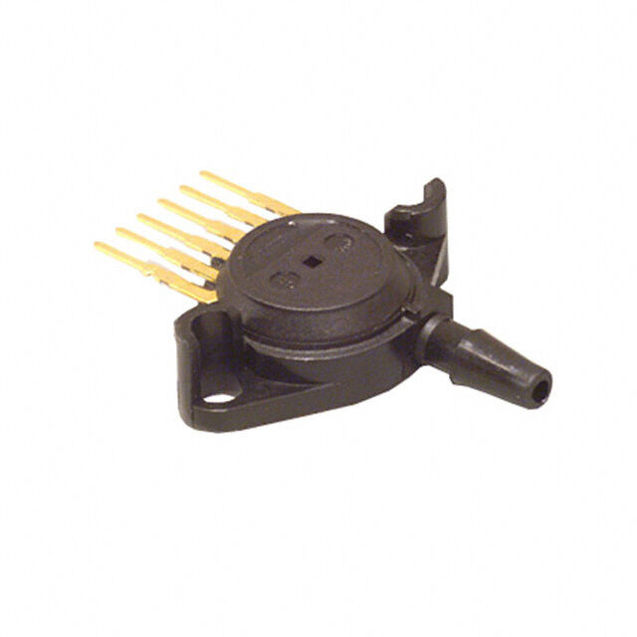
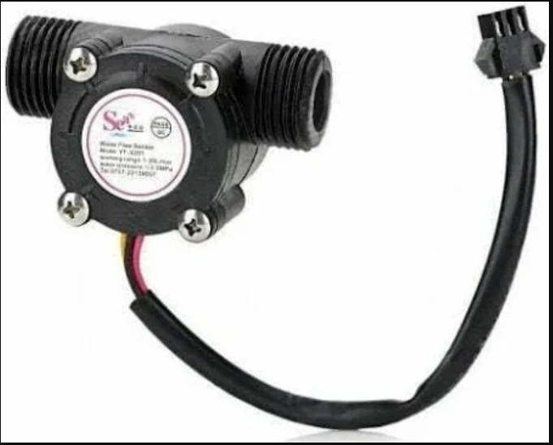
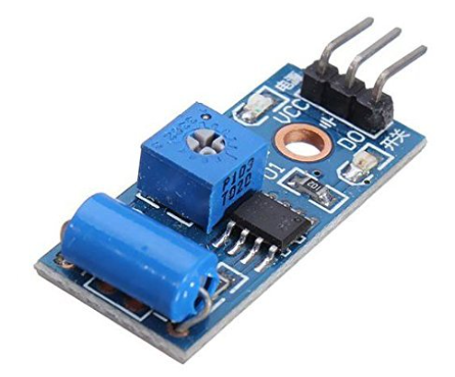
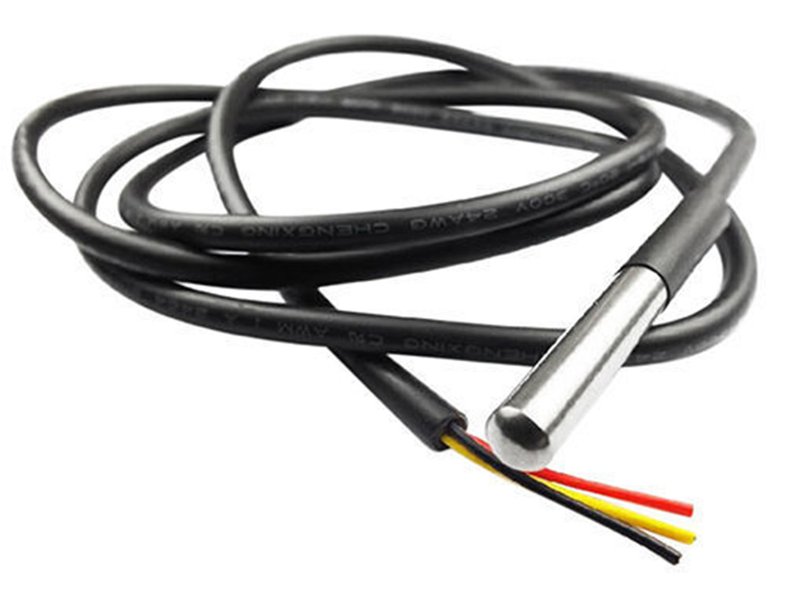
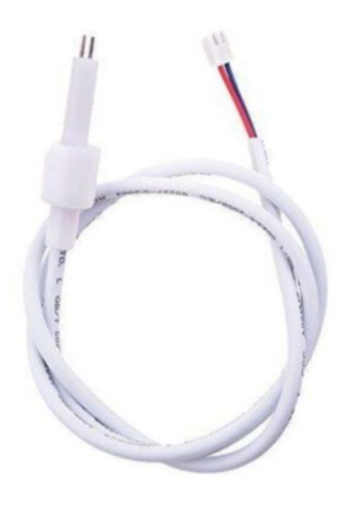
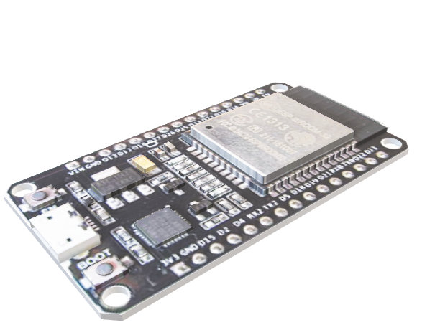
Hardware Components
Predictive Maintenance System for Water Pipelines
Innovexa
ESP32
(WiFi-enabled microcontroller)
Acts as the central processing unit, collecting data from all sensors.
Enables wireless communication to send data to the cloud or a local server for analysis.

Slide 7
Hardware Components
Predictive Maintenance System for Water Pipelines
Innovexa
Sensors
Pressure Sensor (MPX5700AP)
Detects pressure fluctuations.
Water Flow Sensor(YF-S201)
Measures flow rate changes.
Vibration Sensor (SW-420)
Detects unusual vibrations (pipe cracks).
Temperature Sensor (DS18B20)
Monitors pipe overheating risks.
Water Quality Sensor (TDS Sensor)
Detects contamination.

Slide 8
Hardware Components
Predictive Maintenance System for Water Pipelines
Innovexa
Power Supply & Jumper Wires
Provides stable power to the ESP32 and sensors.
Ensures seamless connectivity and data transmission between components.

Slide 9
Software Components
Predictive Maintenance System for Water Pipelines
Innovexa

Slide 10
Software Components
Predictive Maintenance System for Water Pipelines
Innovexa
Embedded System (ESP32 Code)
Arduino IDE (C++)
HTTP Client for API communication
Backend (Flask API)
Python (Flask, MySQL Connector, Twilio API)

Slide 11
Software Components
Predictive Maintenance System for Water Pipelines
Innovexa
Database
MySQL(Stores sensor data)
Machine Learning
LSTM + Autoencoder

Slide 12
Software Components
Predictive Maintenance System for Water Pipelines
Innovexa
Mobile App
Flutter / React Native(Real-time monitoring & alerts)
Notification System
Twilio SMS API
Firebase Cloud Messaging (FCM) for mobile app

Slide 13
AI-Powered Machine Learning Model
Predictive Maintenance System for Water Pipelines
Innovexa
Model Used:
A
LSTM (Long Short-Term Memory) + Autoencoder for Anomaly Detection
Why?
B
Learns pipeline behavior over time, improving failure prediction accuracy.
Data Inputs
C
Pressure (<4.0 = Normal, >4.5 = Leak Risk)
Flow Rate (Unusual flow drop = Leakage)
Vibration (High vibrations indicate cracks)
Temperature (Overheating = Pipe burst risk)
Water Quality (Contamination suggests pipeline damage)

Slide 14
MySQL Database Structure
Predictive Maintenance System for Water Pipelines
Innovexa

Slide 15


Alert & Notification System
Predictive Maintenance System for Water Pipelines
Innovexa
Mobile App Push Notification 📱 (via Firebase)
Twilio SMS Alert
Sends real-time push notifications to the mobile app for immediate attention.
Provides detailed alerts with sensor data and risk level for better decision-making.
Data Stored in MySQL
Sends instant SMS alerts to the maintenance team when sensor values indicate a failure risk.
Ensures quick response to prevent pipeline damage or leaks.
Logs all sensor data and alerts in a MySQL database for future analysis.
Enables tracking of pipeline health trends and improving predictive accuracy.

Slide 16
Mobile App Features
Predictive Maintenance System for Water Pipelines
Innovexa
Dashboard
Maintenance Report
A
C
Displays real-time sensor readings.
View pipeline health history.
Notification System
Predictive Alerts
B
D
Alerts users about potential failures.
AI-driven insights for proactive maintenance.

Slide 17
Advantages & Future Scope
Predictive Maintenance System for Water Pipelines
Innovexa
01
Advanatges
AI-Powered Prediction → Reduces Maintenance Costs
Multi-Sensor Approach → Higher Accuracy
Real-Time Alerts → Faster Response
Scalable → Smart Cities & Rural Deployments
02
Future Enhancements
AI-Driven Self-Healing Pipelines – Autonomous leak control.
GIS Mapping – Location-based maintenance analytics.
Blockchain for Secure Data Logging – Prevents tampering.

Slide 18
Conclusion
Predictive Maintenance System for Water Pipelines
Innovexa
Developed a Predictive Pipeline Maintenance System using ESP32, ML & IoT sensors.
Real-time monitoring + AI-powered alerts improves maintenance efficiency.
Potential Impact: Can be scaled for municipalities, industries, and rural water management.

Slide 19
Predictive Maintenance System for Water Pipelines
Innovexa
THANK YOU

